Slide 1
MOCK INTER-IIT TECH MEET 15.0 · VLSI DESIGN TRACK
Designing a High-Resolution
Delta-Sigma ADC
Our Solution: From First-Order Modulator to a Validated Simulink Model
Solution Walkthrough & Simulation Results — July 2026
DELTA-SIGMA ADC — MOCK INTER-IIT TECH MEET 15.0
1

Slide 2




THE BRIEF
What the Problem Statement Asked For
A first-order, single-bit Delta-Sigma ADC — modulator + digital decimation filter — for slow-varying, high-resolution sensor channels.
1st Order
64 – 256
0.5 – 2 kSPS
10 – 12 bit
Single-bit modulator
Oversampling Ratio (OSR)
Target output data rate
Target ENOB
Our job: turn these constraints into a working, verified MATLAB/Simulink design.
DELTA-SIGMA ADC — MOCK INTER-IIT TECH MEET 15.0
2

Slide 3


OUR SOLUTION
Solution at a Glance — Three Building Blocks
01
02
03
Delta-Sigma Modulator
CIC Decimation Filter
Performance Evaluation
Sum → Discrete Integrator → 1-bit Comparator, closed with a unity-gain 1-bit DAC feedback path. Produces the oversampled bitstream.
→
3-stage Integrator Cascade + Zero-Order Hold + 3-stage Comb Cascade. Multiplier-free, hardware-realizable noise removal & down-sampling.
→
Windowed FFT of the decimated output extracts fundamental & noise power → SNR and ENOB, verified against theory.
Input signal enters the modulator; the bitstream is filtered & decimated by the CIC filter; the analysis stage closes the loop with measured SNR/ENOB.
DELTA-SIGMA ADC — MOCK INTER-IIT TECH MEET 15.0
3

Slide 4
BUILDING BLOCK 1
First-Order Delta-Sigma Modulator
1
Summing Node
Simulink Realization
Input minus DAC feedback → error signal x[n].
2
Discrete-Time Integrator
K·Ts /(z−1) accumulator — y[n]=y[n−1]+x[n−1].
x(t)
Input
Σ
Sum
K·Ts/(z−1)
Integrator
Relay
1-bit Q.
v[n]
Bitstream
3
1-bit Quantizer (Relay)
Comparator with output levels ±1, clocked at fs.
1-bit DAC Feedback (unity gain)
4
Unity-Gain DAC Feedback
Inherently linear 2-level feedback closes the loop.
Design choice: input amplitude backed off ~6 dBFS below full scale to keep the loop stable and avoid integrator overload.
DELTA-SIGMA ADC — MOCK INTER-IIT TECH MEET 15.0
4

Slide 5
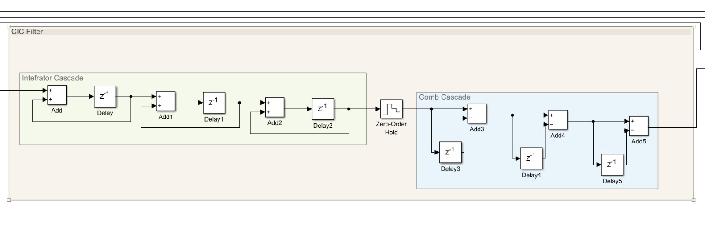
BUILDING BLOCK 2
CIC Decimation Filter — Our Simulink Realization
Integrator Cascade
Zero-Order Hold + ÷M
Comb Cascade
3 cascaded accumulator (1/(1−z⁻¹)) stages at the high rate fs — order K = 3.
Holds & down-samples by the decimation factor M = OSR before the comb stages.
3 cascaded differentiator ((1−z⁻ᴹ)) stages at the reduced rate — adders & delays only, no multipliers.
DELTA-SIGMA ADC — MOCK INTER-IIT TECH MEET 15.0
5

Slide 6
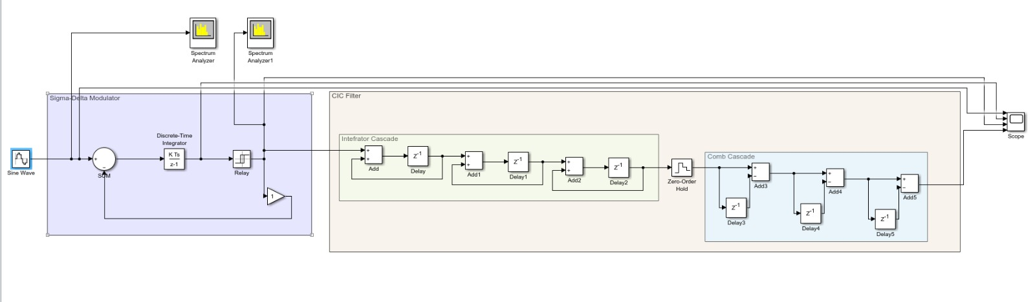
INTEGRATION
Complete ADC Chain — End-to-End Simulink Model
Sine Wave source drives the Sigma-Delta Modulator (SUM → K·Ts/(z−1) integrator → Relay quantizer → feedback).
Modulator bitstream feeds directly into the CIC Filter subsystem for noise removal and decimation.
Two Spectrum Analyzers tap the bitstream and filtered output; a 4-trace Scope records the full signal chain.
DELTA-SIGMA ADC — MOCK INTER-IIT TECH MEET 15.0
6

Slide 7
DESIGN VERIFICATION
Does Our Design Meet the Spec? — The Math
Working point: fs = 128 kHz · target output data rate fodr = 1000 SPS
Step 1 — Oversampling Ratio
Step 2 — Predicted SNR
Step 3 — Effective Bits
OSR = f_{s} / f_{odr}
SNR_{dB} ≈ 6.02+1.76−5.17
+ 30·log
₁₀(OSR)
ENOB = (SNR_{dB} − 1.76)/6.02
= 128,000 / 1,000
= (65.83 − 1.76) / 6.02
= 2.61 + 30·log₁₀(128) = 2.61 + 63.22
OSR = 128
SNR ≈ 65.83 dB
ENOB ≈ 10.64 bits
Result: OSR = 128 sits inside the 64–256 window, and the predicted ENOB ≈ 10.64 bits falls inside the 10–12 bit target — our chosen operating point satisfies every problem-statement constraint.
DELTA-SIGMA ADC — MOCK INTER-IIT TECH MEET 15.0
7

Slide 8
EXPERIMENTAL VALIDATION
OSR Sweep — From Trials to Final Design
We didn’t stop at hand-calculation — we swept OSR across the full 64–256 range in Simulink and measured SNR/ENOB directly from the FFT of each decimated output.
OSR
f_out (SPS)
Measured SNR (dB)
ENOB (bits)
64
2000
56.88
9.16
96
1,333.3
63.21
10.21
128
1,000
67.48
10.92
★ Our design point
192
666.7
72.18
11.70
256
500
75.28
12.21
Matches theory: SNR rises ≈ 9–10 dB per octave of OSR (≈ 30 dB/decade) — the same law as our first-order noise-shaping prediction.
At OSR = 128: predicted ENOB ≈ 10.64 bits vs measured 10.92 bits — within 0.3 bit, confirming the design math.
DELTA-SIGMA ADC — MOCK INTER-IIT TECH MEET 15.0
8

Slide 9
EXPERIMENTAL VALIDATION
CIC Filter Order — Why K = 3?
With OSR held fixed at 128, we also swept the CIC filter degree (K = 1, 2, 3) to check how much resolution each extra integrator/comb stage actually buys us.
CIC Degree (K)
Constant OSR
Measured SNR (dB)
ENOB (bits)
1
128
37.75
5.98
2
128
64.76
10.47
3
128
67.28
10.88
★ Our design point
Diminishing returns, confirmed: K = 1 → 2 adds +4.49 bits of ENOB — a huge jump. K = 2 → 3 adds only +0.41 bit.
Why we stop at K = 3: it already clears our 10–12 bit ENOB target (10.88 bits), so a 4th stage would add hardware cost for negligible extra resolution.
DELTA-SIGMA ADC — MOCK INTER-IIT TECH MEET 15.0
9

Slide 10
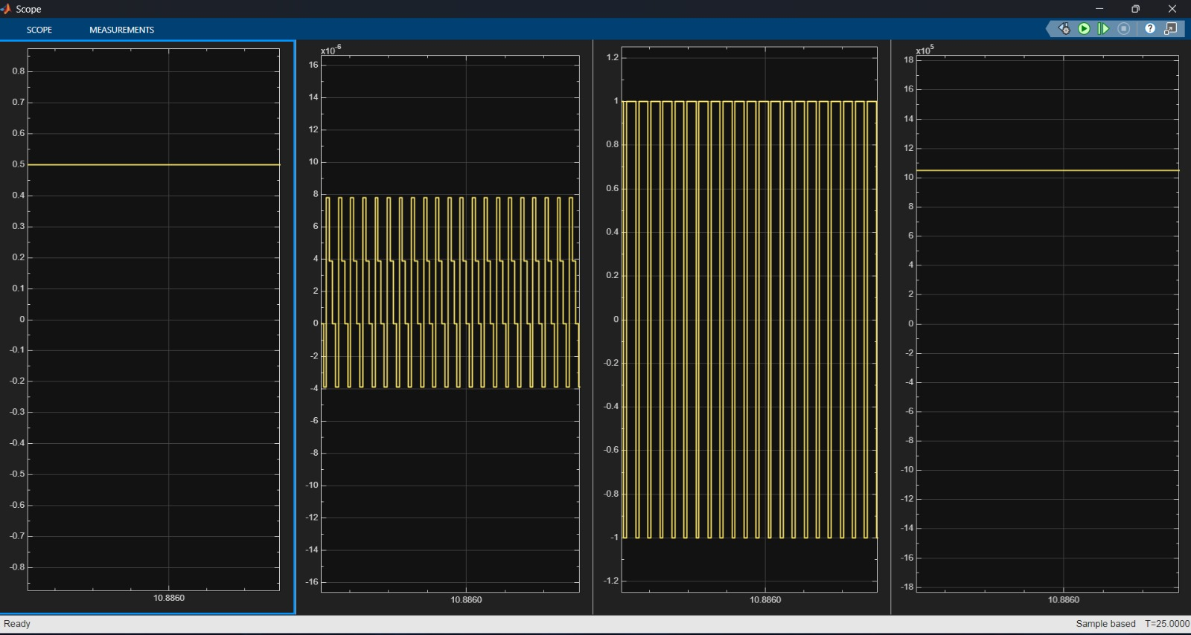
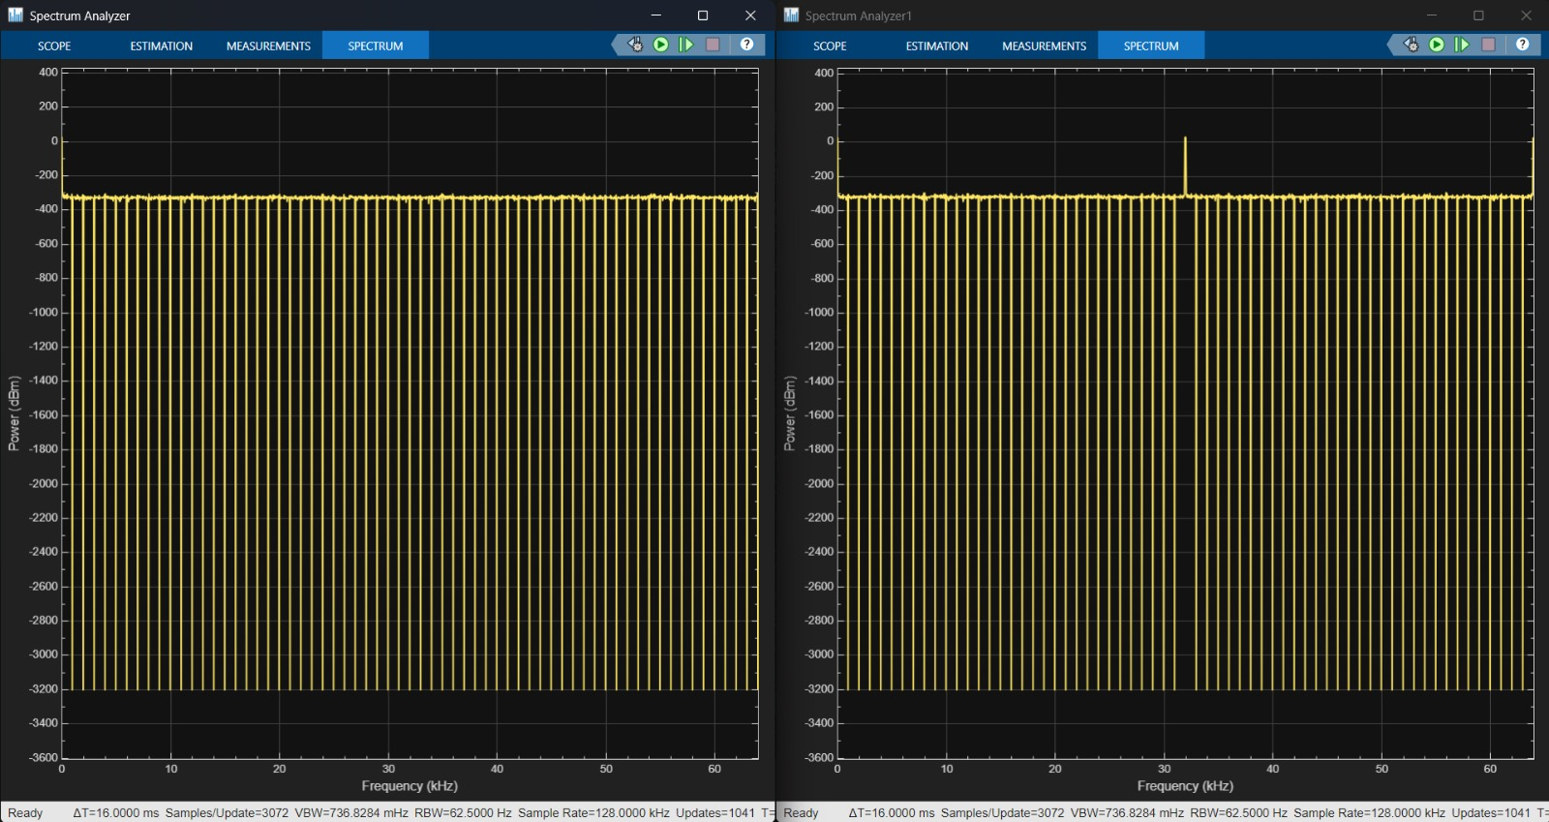
RESULT 1
Validation with a Constant (DC) Input
Constant input → fixed bitstream duty cycle.
Spectrum shows periodic idle tones — expected for a DC input in a first-order 1-bit loop.
Decimated output settles to a steady value — correct DC reconstruction.
Scope: input · bitstream · 1-bit output · decimated output
DELTA-SIGMA ADC — MOCK INTER-IIT TECH MEET 15.0
10

Slide 11
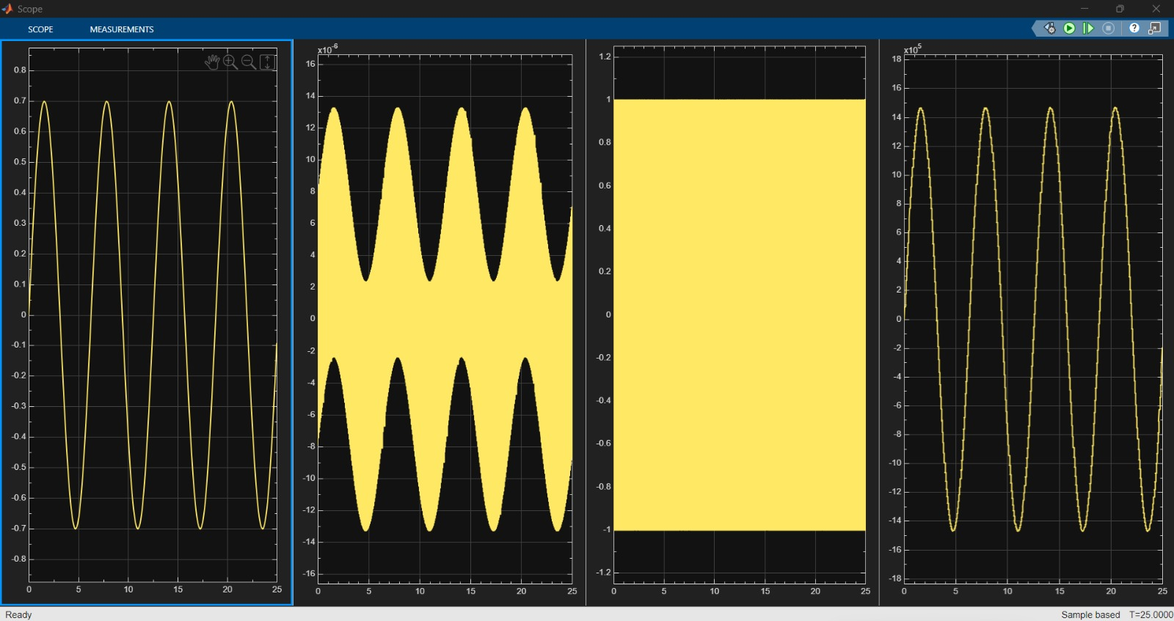
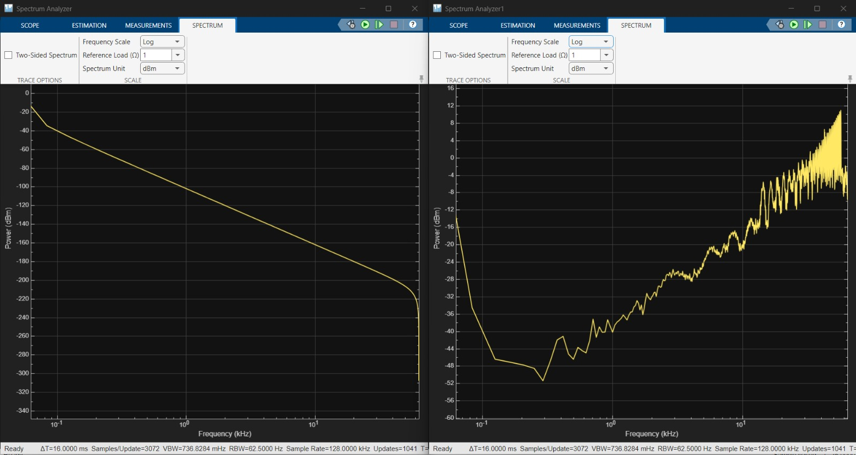
RESULT 2
Validation with a Sinusoidal Input
Power vs. log-frequency — same OSR = 128 sine test
Reconstructed output tracks the input sine’s shape and amplitude.
On a log-frequency axis the noise floor climbs steadily toward fs/2 — first-order noise shaping, directly visible.
Signal tone stays clear of the shaped noise floor near DC.
Scope: input sine · bitstream · 1-bit output · reconstructed output
DELTA-SIGMA ADC — MOCK INTER-IIT TECH MEET 15.0
11

Slide 12




SYNTHESIS
What Our Results Prove
Noise Shaping — Confirmed in Practice
Both DC and AC signals reconstruct correctly
The measured bitstream spectrum and the OSR-sweep SNR trend both match the |NTF(f)| = 2sin(πf/fs) prediction.
Constant and sinusoidal test inputs are both recovered faithfully at the CIC filter output.
A known limitation shows up honestly
Theory and simulation agree
DC input produces idle tones / limit cycles — an expected first-order single-bit artifact, not a design flaw.
Predicted ENOB (10.64 bits) and measured ENOB (10.92 bits) at OSR = 128 differ by only 0.3 bit.
DELTA-SIGMA ADC — MOCK INTER-IIT TECH MEET 15.0
12

Slide 13
WHY THIS APPROACH WORKS
Built for Precision Sensor Interfaces
Analog simplicity
Robust to component drift
Only an integrator, one comparator, and an inherently-linear 1-bit DAC — minimal analog to trust.
Resolution comes from oversampling + digital filtering, not tightly matched analog components.
Multiplier-free hardware
Resolution is a dial, not a redesign
CIC filter uses only adders and delays — straightforward, low-power FPGA/ASIC realization.
Trade ENOB against bandwidth purely via OSR / filter order — same analog topology throughout.
DELTA-SIGMA ADC — MOCK INTER-IIT TECH MEET 15.0
13

Slide 14
WHAT'S NEXT
Roadmap for Future Improvement
1
Higher-order / MASH modulators
40–60 dB/decade shaping → same ENOB at lower OSR.
2
Multi-bit quantizer + DEM
Lower quantization step, better stability margin.
3
Continuous-time loop filter
Higher fs at lower power; inherent anti-aliasing.
4
Chopping / auto-zeroing
Suppresses 1/f noise & offset for very low-bandwidth sensors.
5
FPGA/ASIC RTL of the CIC filter
Verilog/VHDL synthesis, hardware-in-the-loop verification against this MATLAB/Simulink model.
DELTA-SIGMA ADC — MOCK INTER-IIT TECH MEET 15.0
14

Slide 15
Thank You
Questions & Discussion
DELTA-SIGMA ADC — MOCK INTER-IIT TECH MEET 15.0
15

